Slide 1
Small-scale database implementation – Query By Example (QBE)
Week 6
Dr. Farshid Keivanian

Slide 2
Week 6 Outline
Why Practice Microsoft Access?
Query by Example (QBE) in Access
Hands-on Activity 1: Create QRY_CustomerCity
Adding Criteria to Queries
Hands-on Activity 2: Filter Reservations by Date & Day (OR)
Building Flexible Queries
Hands-On Activity 3: Count Customers per ClassType
Action Queries
Hands-On Activity 4: Update “Cardio” Prices (+10%)
Research / Debate Questions
Preparation for Tutorial Week 6
Review and Feedback on Tutorial Week 4 and 5

Slide 3
Why Practice Microsoft Access?
Why this matters
Helps you organise and manage data easily
Teaches you how to find useful information quickly
Builds skills used in real jobs and businesses

Slide 4
Why Practice Microsoft Access?
Why we practice
Practice helps you understand how databases work
You learn by doing, not just watching
It improves your problem-solving skills

Slide 5
Why Practice Microsoft Access?
Big Picture: Beyond Microsoft Access
Today, many companies and universities use:
SQL Databases (MySQL, PostgreSQL, SQL Server)
Cloud systems (Google BigQuery, AWS, Azure)
Data tools (Power BI, Tableau)
Think of it like a system:
Database (SQL) → stores data
Cloud → stores and runs the database online
Data tools → show the data in charts/dashboards

Slide 6
Why Practice Microsoft Access?
Simple Example (Gym System)
Step 1: Data is stored (SQL Database) Table: Customers
CustomerID | Name | Class | Day
1 | Alex | Cardio | Wednesday
2 | Mia | Strength | Friday

Slide 7
Why Practice Microsoft Access?
Step 2: Ask a question (SQL Query) “Show customers in Cardio classes”
SELECT Name FROM Customers WHERE Class = 'Cardio';
Result: Alex

Slide 8
Why Practice Microsoft Access?
Step 3: Cloud system (BigQuery / AWS / Azure)
Stores this database online
Allows access from anywhere
Handles large amounts of data

Slide 9
Why Practice Microsoft Access?
Step 4: Data tool (Power BI / Tableau)
Turns results into charts & dashboards
Example:
Bar chart: Number of customers per class
Pie chart: % of class types

Slide 10
Why Practice Microsoft Access?
Flow (Big Picture)
Users/Apps
(website, mobile app, staff using system)
SQL Database
(e.g. MySQL, SQL Server, PostgreSQL)
(e.g. Microsoft Azure, AWS) - hosts the database online - runs the system (servers, storage)
Cloud Platform
SQL Query
(written by developers / analysts) asks questions from the database
Power BI / Tableau
creates dashboards, charts, reports

Slide 11
Why Practice Microsoft Access?
Where is Microsoft Access used?
Microsoft Access is usually used here instead:
- stores data + forms + queries in ONE file - used for small systems (school, small business)
Users/Apps
Microsoft Access
Faculty of Business and Law | Peter Faber Business School

Slide 12
Why Practice Microsoft Access?
So:
Access = all-in-one tool (small scale)
SQL + Cloud + BI tools = modern large systems
Faculty of Business and Law | Peter Faber Business School

Slide 13
Why Practice Microsoft Access?
In Simple:
Access = basic learning tool
SQL = language to talk to data
Cloud = where data lives today
Power BI/Tableau = how results are shown

Slide 14
Why Practice Microsoft Access?
Simple Comparison
Tool | Where it fits | Used for
Microsoft Access | Local system | Learning, small databases
SQL Database | Core data layer | Storing structured data
Azure / AWS | Cloud platform | Hosting databases & apps
Power BI / Tableau | Data visualization | Reports & dashboards

Slide 15
Why Practice Microsoft Access?
Real-Life Example
Gym system:
Customers book classes → (Users/App)
Data saved → (SQL Database)
Runs online → (Azure / AWS)
Analyst checks data → (SQL Query)
Manager sees report → (Power BI dashboard)

Slide 16
Why Practice Microsoft Access?
Key Takeaway:
“Microsoft Access does everything in one place for small systems.
But real companies split it into parts: database, cloud, and reporting tools.”

Slide 17
Query by Example (QBE) in Access
What:
Query By Example (QBE) lets you build queries visually in Access without writing SQL.
Why:
It’s beginner-friendly—just drag and drop fields instead of coding.
Analogy:
Think of it like Excel filters with criteria, but in Access you can save and reuse it.

Slide 18
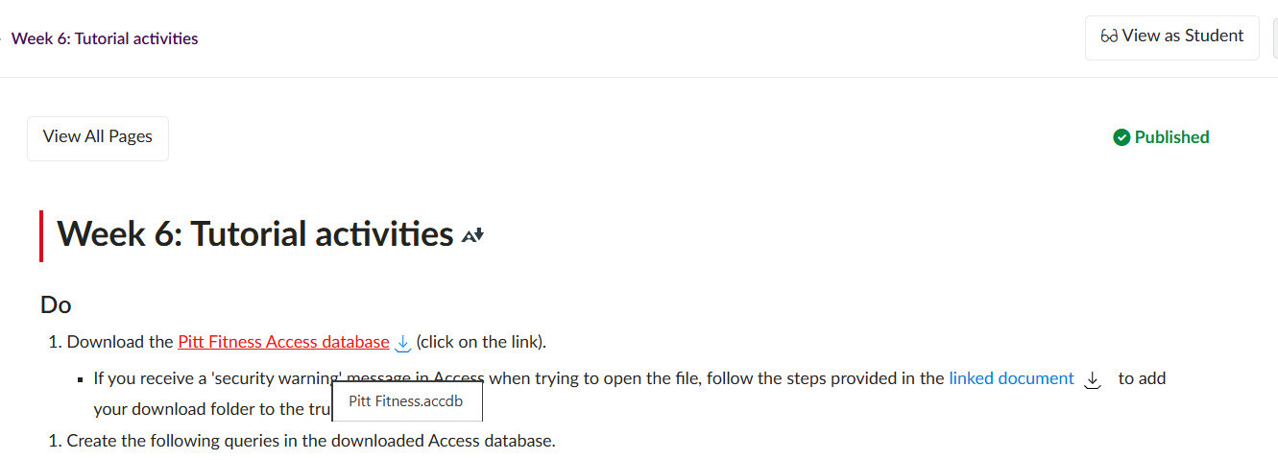
Query by Example (QBE) in Access
Example (Pitt Fitness DB):
Download Pitt Fitness DB

Slide 19
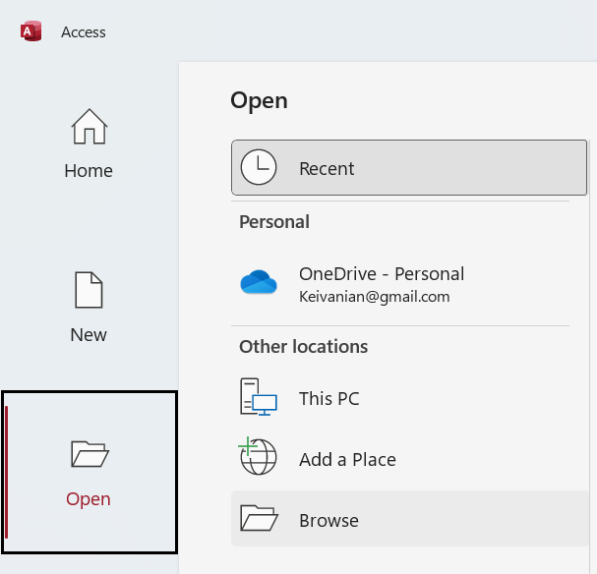
Query by Example (QBE) in Access
Example (Pitt Fitness DB):
Open Create → Query Design

Slide 20
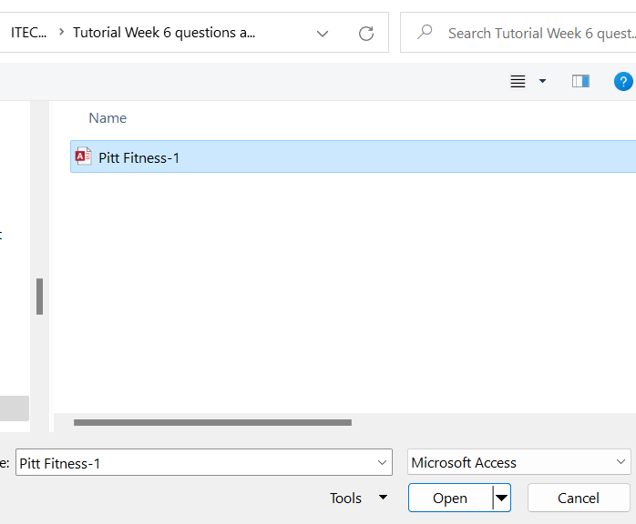
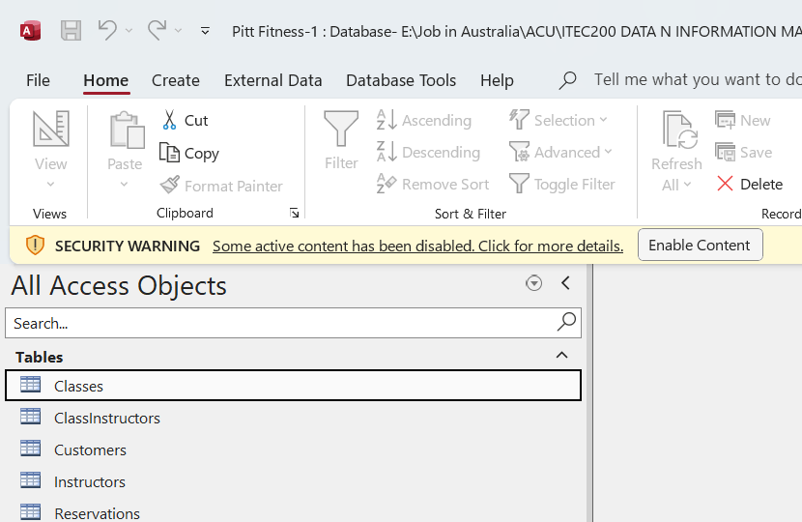
Query by Example (QBE) in Access

Slide 21
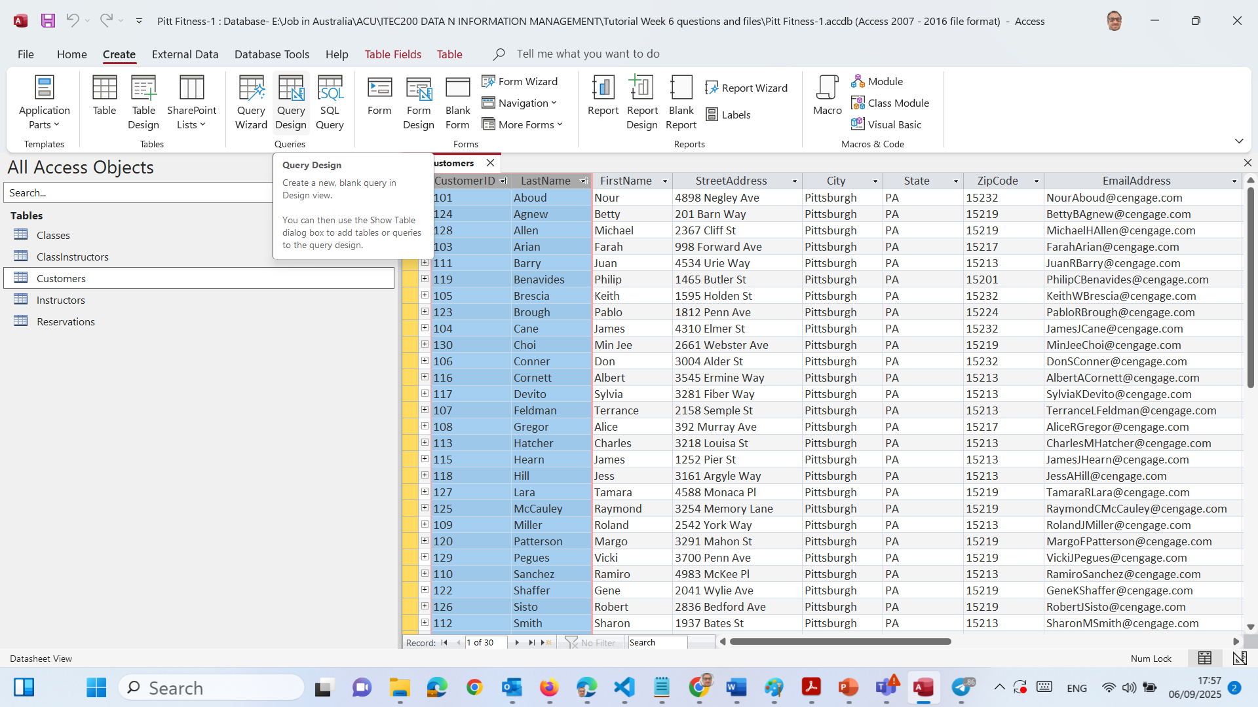
Query by Example (QBE) in Access
On the top menu, go to Create → Query Design.

Slide 22
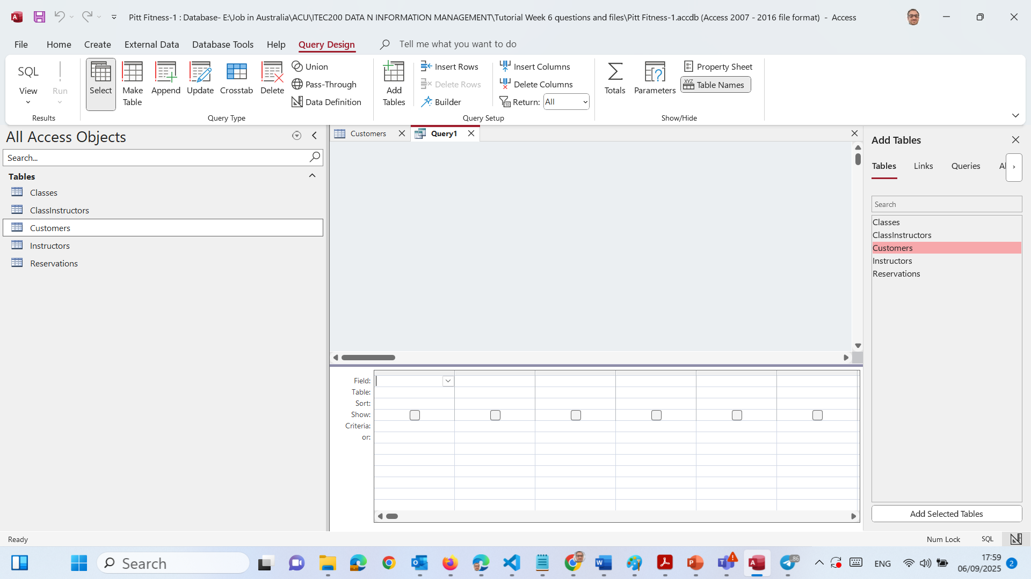
Query by Example (QBE) in Access
Double Click Customers

Slide 23
Query by Example (QBE) in Access
We’ll see the Query Design View with the grid at the bottom (rows for Field, Table, Sort, Show, Criteria).

Slide 24
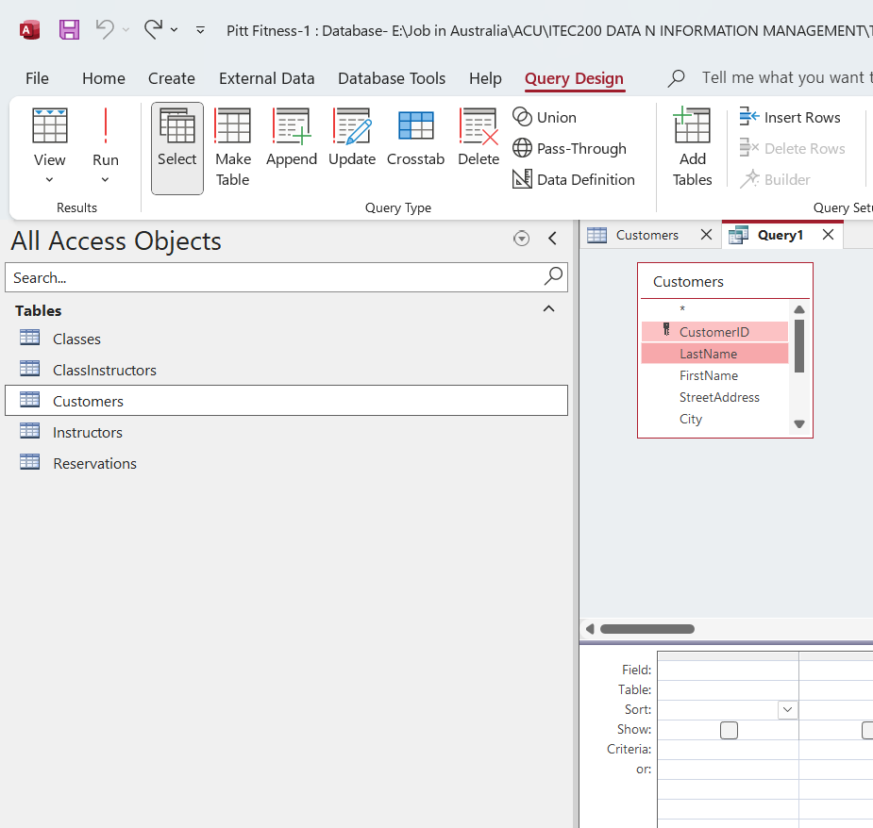
Query by Example (QBE) in Access
Press Ctrl and Select CustomerID and LastName

Slide 25
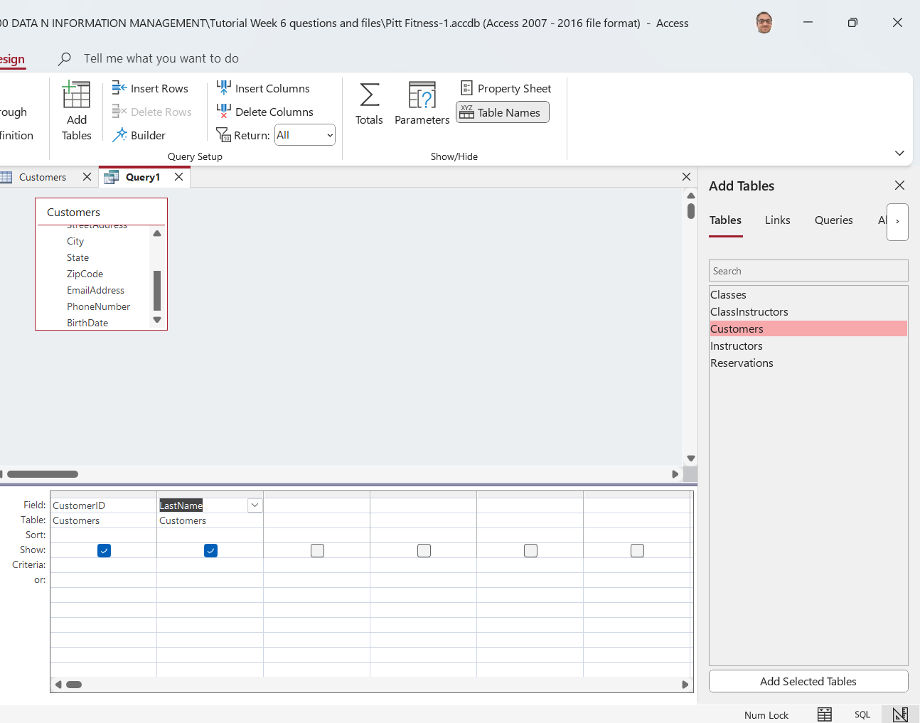
Query by Example (QBE) in Access
Drag them from the Customers table into the grid.

Slide 26
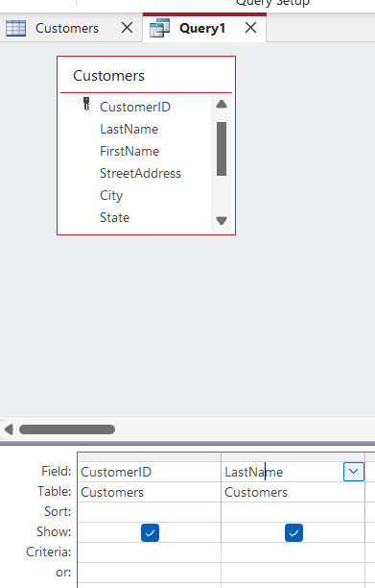
Query by Example (QBE) in Access

Slide 27
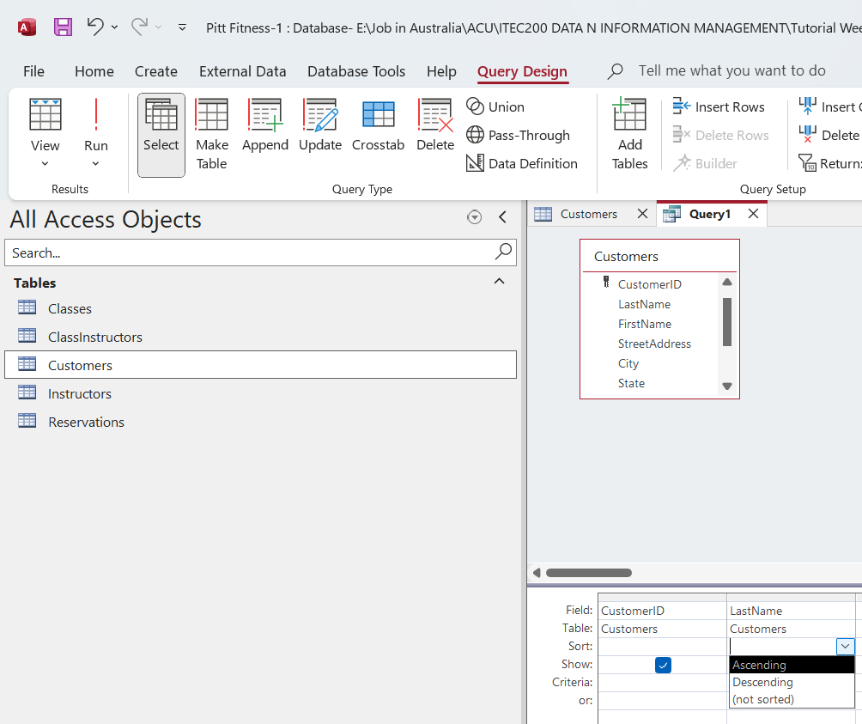
Query by Example (QBE) in Access
Under Sort for LastName → select Ascending.

Slide 28
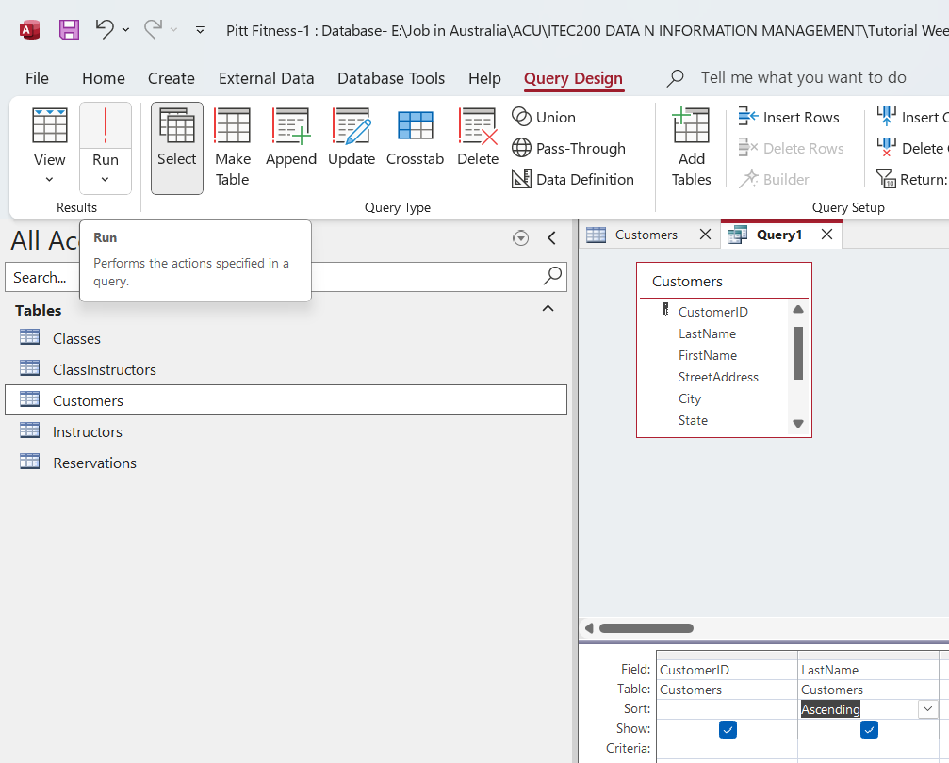
Query by Example (QBE) in Access
Click Run (red !) to see results.

Slide 29
Hands-on Activity 1: Create QRY_CustomerCity
Task: Build and save a query that shows LastName and City, sorted A–Z by LastName (3-4 minutes)

Slide 30
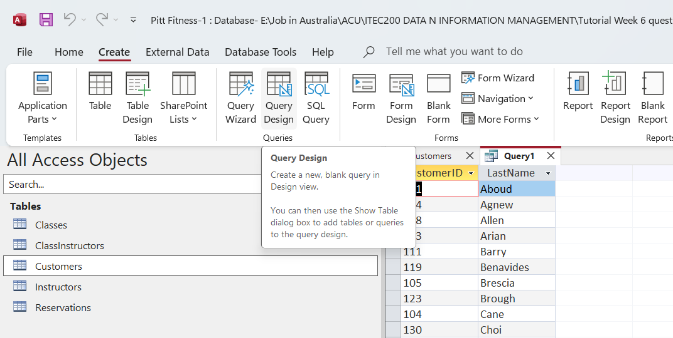
Hands-on Activity 1: Create QRY_CustomerCity
Go to Create → Query Design

Slide 31
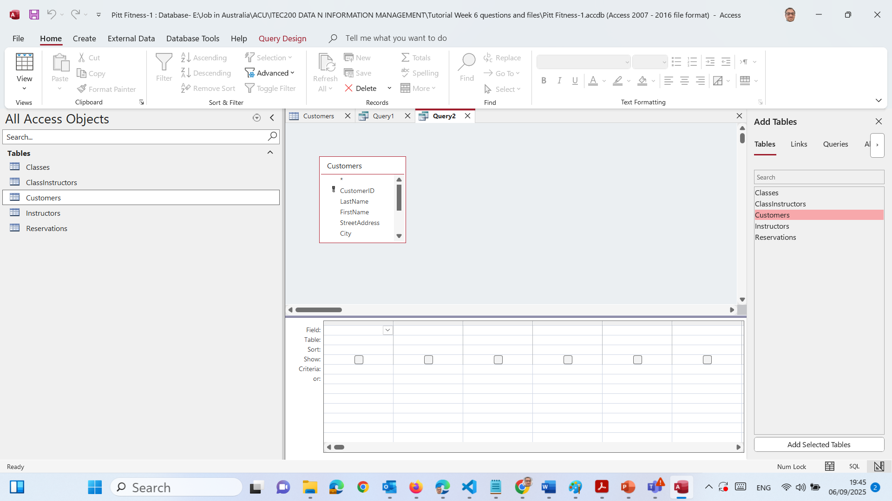
Hands-on Activity 1: Create QRY_CustomerCity
In Show Table, double-click Customers → Close

Slide 32
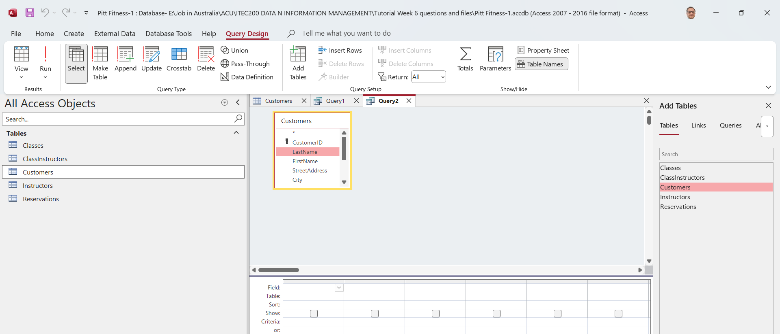
Hands-on Activity 1: Create QRY_CustomerCity
In the top pane, drag LastName to the first column of the grid

Slide 33
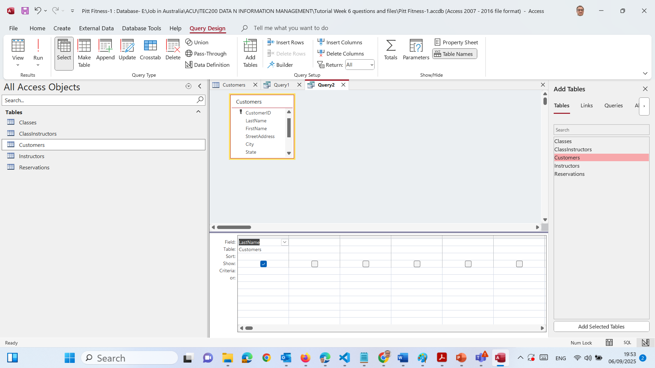
Hands-on Activity 1: Create QRY_CustomerCity
In the top pane, drag LastName to the first column of the grid

Slide 34
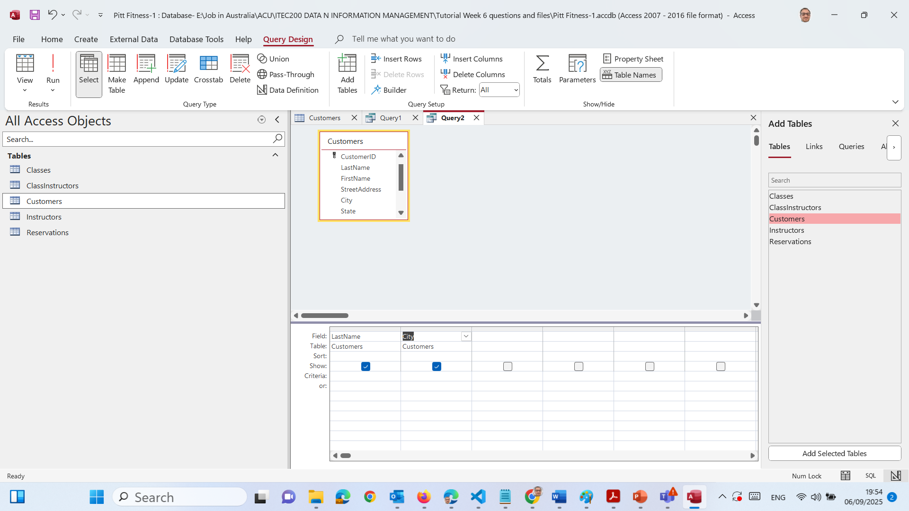
Hands-on Activity 1: Create QRY_CustomerCity
4. Drag City to the second column

Slide 35

Hands-on Activity 1: Create QRY_CustomerCity
5. In the Sort row under LastName, choose Ascending

Slide 36
Hands-on Activity 1: Create QRY_CustomerCity
6. Make sure Show is ticked for both fields

Slide 37
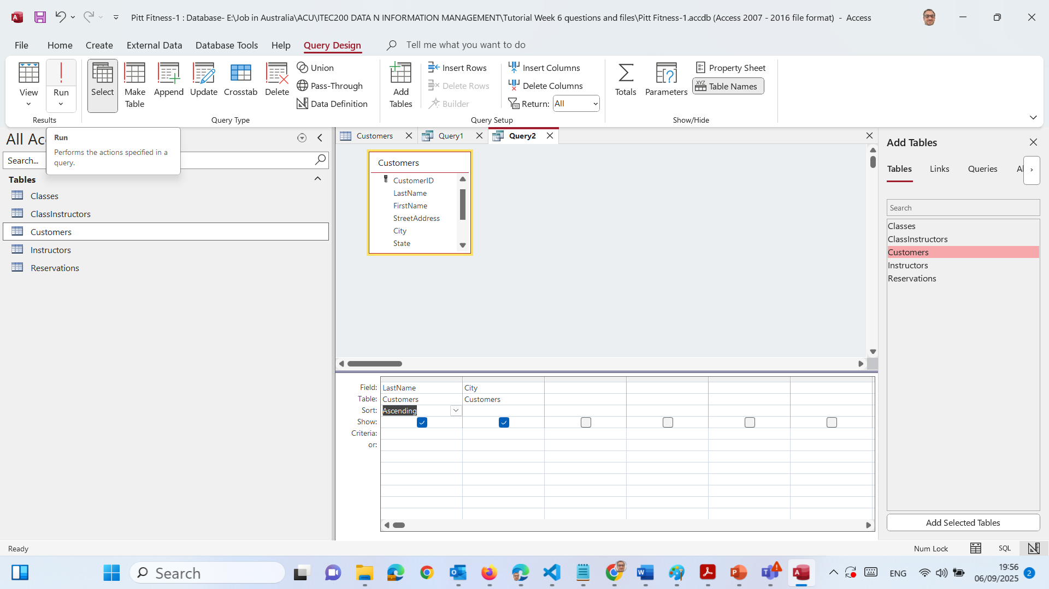
Hands-on Activity 1: Create QRY_CustomerCity
7. Click Run (red !) to view results

Slide 38
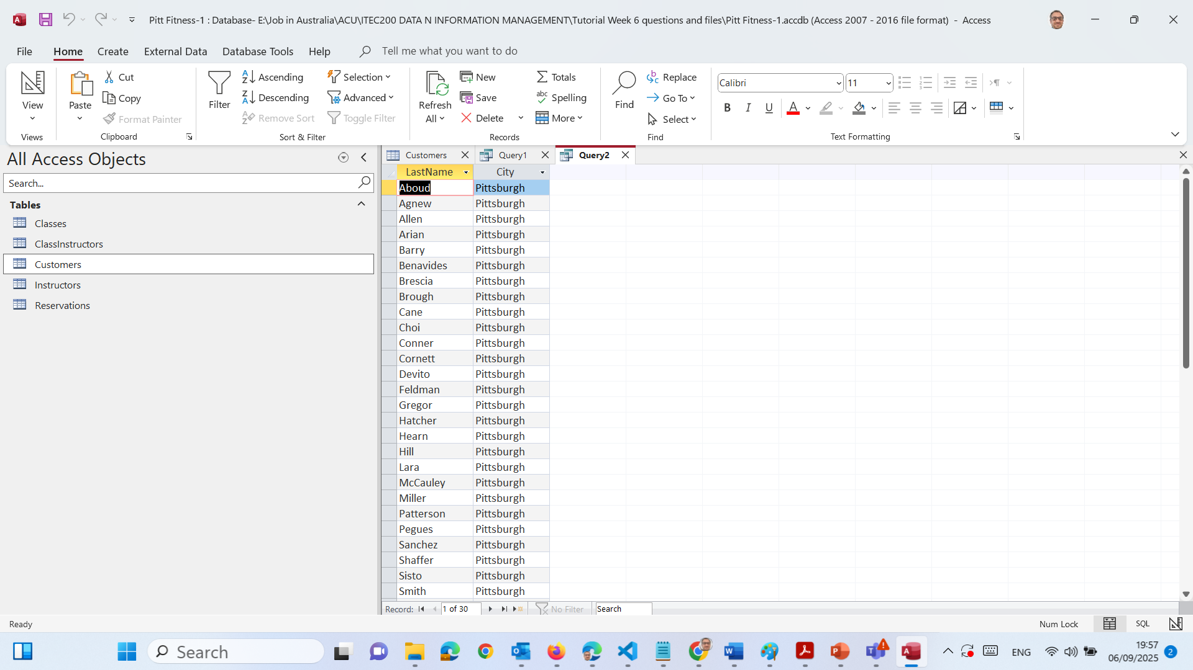
Hands-on Activity 1: Create QRY_CustomerCity
8. Click Save (ctrl + S), name the query QRY_CustomerCity → OK

Slide 39
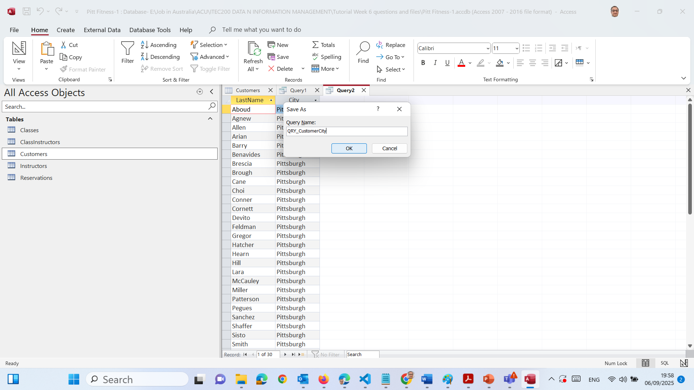
Hands-on Activity 1: Create QRY_CustomerCity

Slide 40
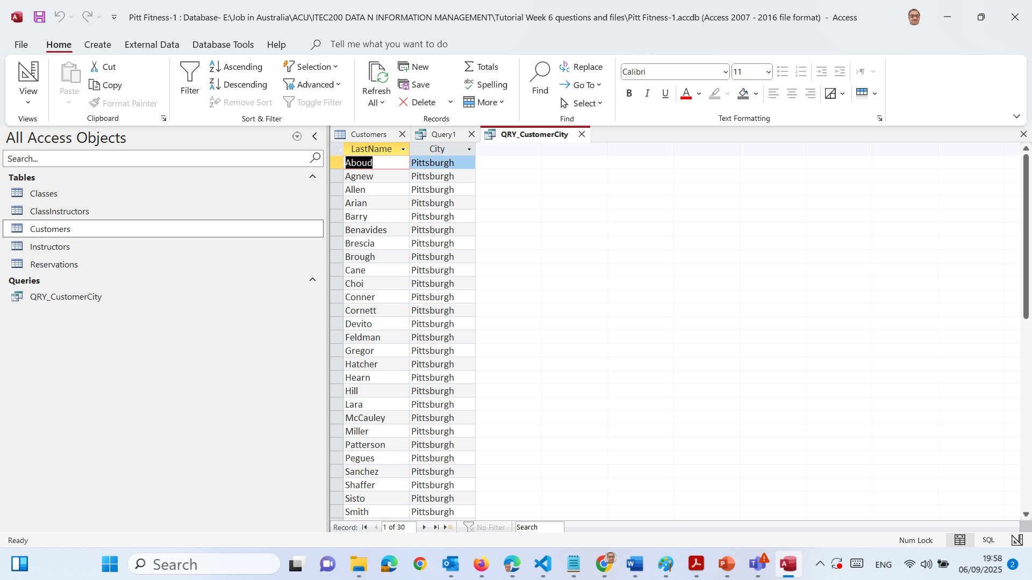
Hands-on Activity 1: Create QRY_CustomerCity

Slide 41
Adding Criteria to Queries
What:
Criteria = filters we add to a query.
Why:
They help us find only the records we want.
Analogy:
Like shopping online at Woolworths and filtering for “Milk under $5”.
Examples:
Find products with Price > 200
Find names starting with “M” → LIKE "M*"

Slide 42

Hands-on Activity 2: Filter Reservations by Date & Day (OR)
Task: Show customers who have a reservation on 1/7/2021, then filter to Wednesday OR Friday.

Slide 43
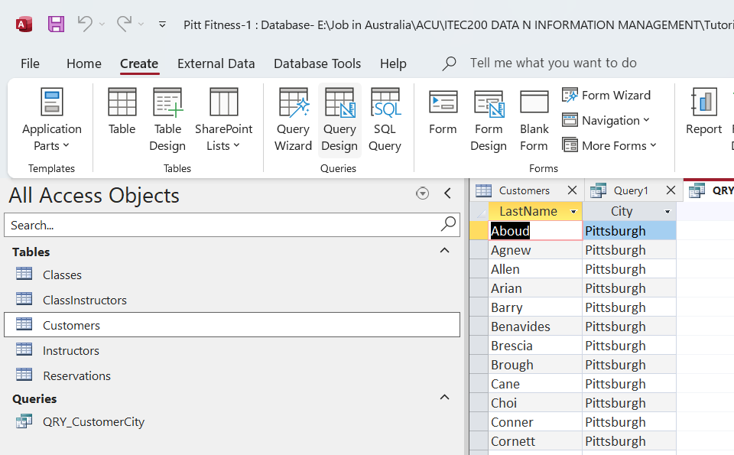
Hands-on Activity 2: Filter Reservations by Date & Day (OR)
Create → Query Design

Slide 44
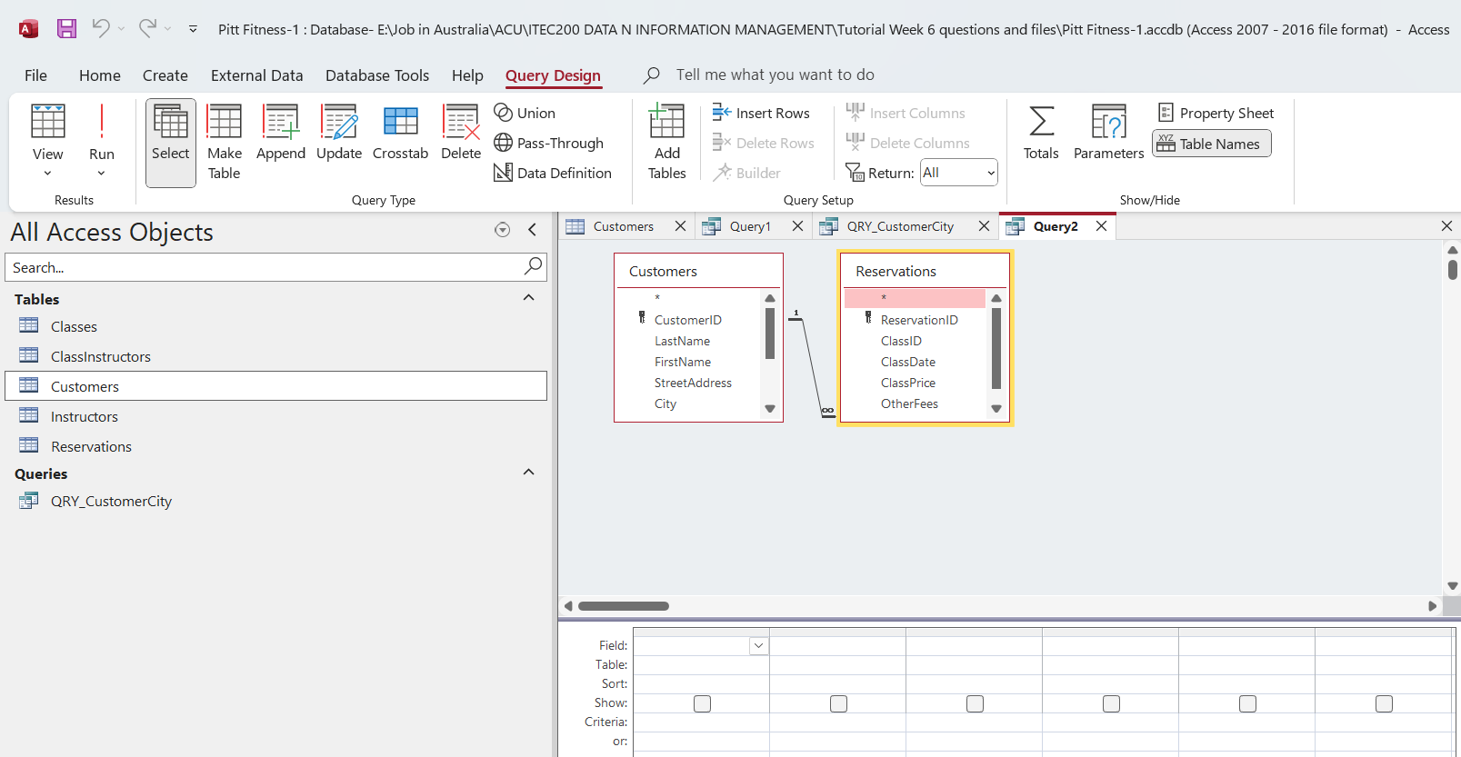
Hands-on Activity 2: Filter Reservations by Date & Day (OR)
Add Customers and Reservations tables → Close

Slide 45
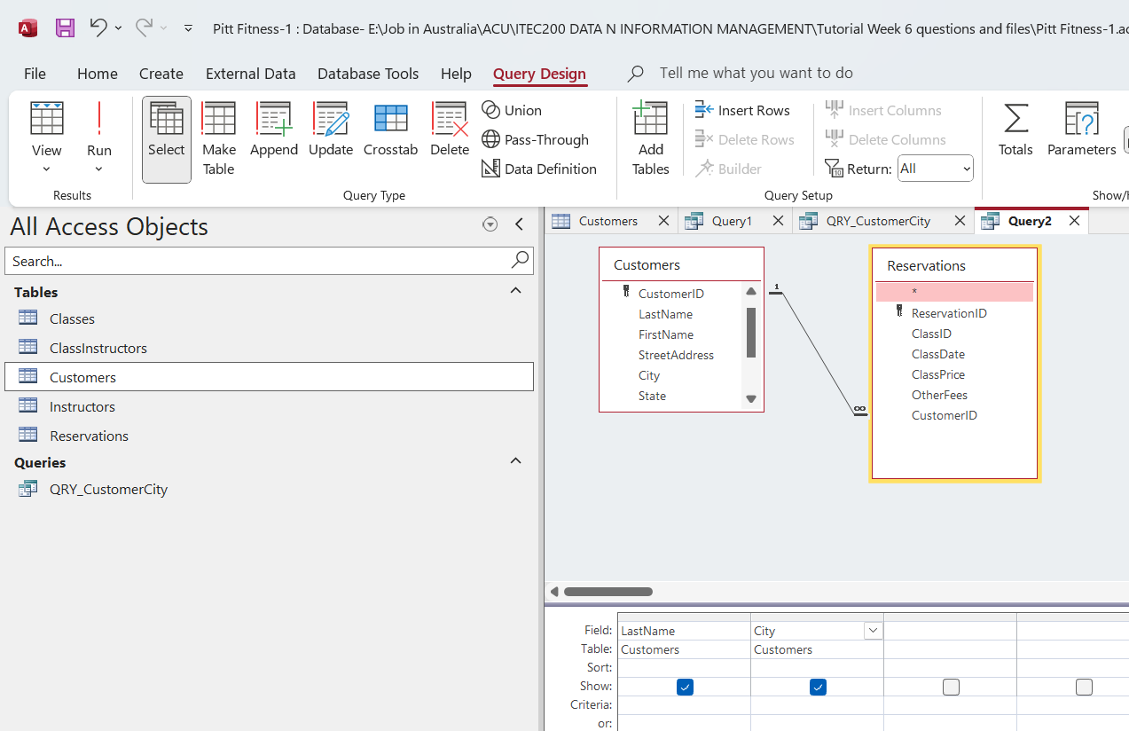
Hands-on Activity 2: Filter Reservations by Date & Day (OR)
Add fields to the grid: Drag LastName (Customers), Drag City (Customers)
LastName and City (from Customers) → That shows who the customer is and where they live.

Slide 46
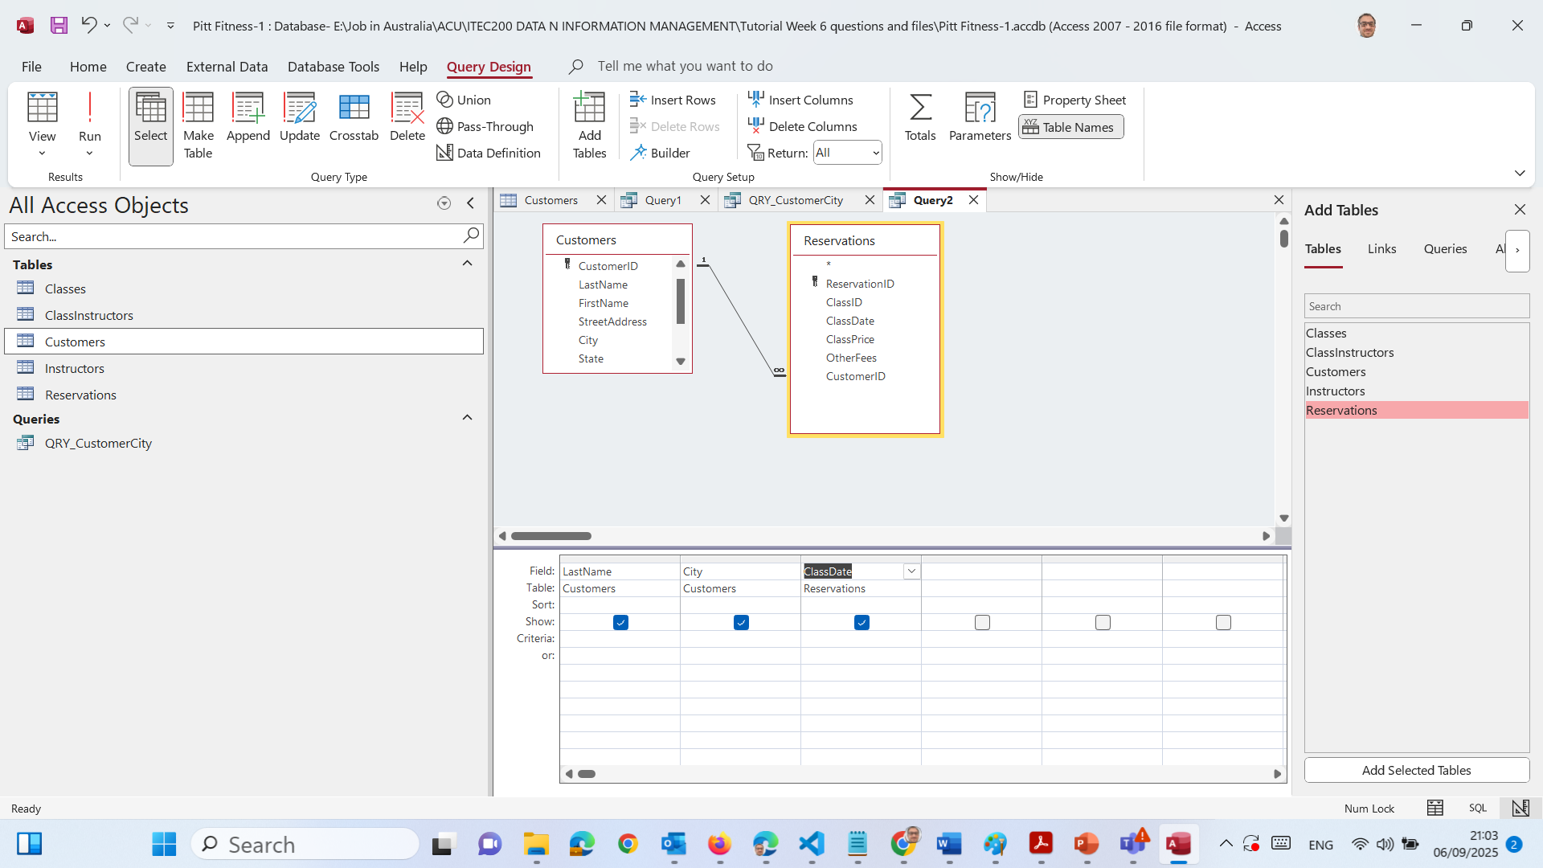
Hands-on Activity 2: Filter Reservations by Date & Day (OR)
Drag ClassDate (Reservations) → this will act as the ReservationDate

Slide 47
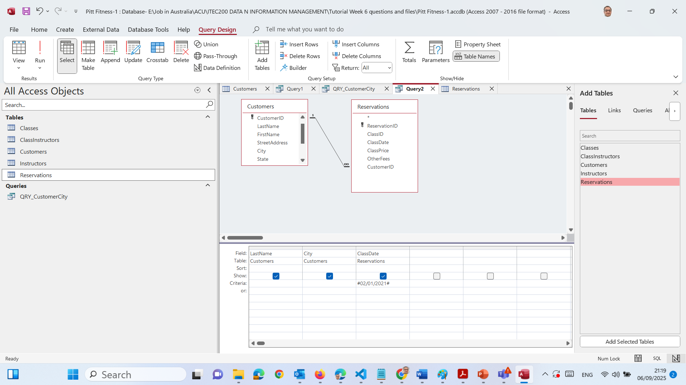
Hands-on Activity 2: Filter Reservations by Date & Day (OR)
4. In the Criteria row under ClassDate → type #02/01/2021#

Slide 48
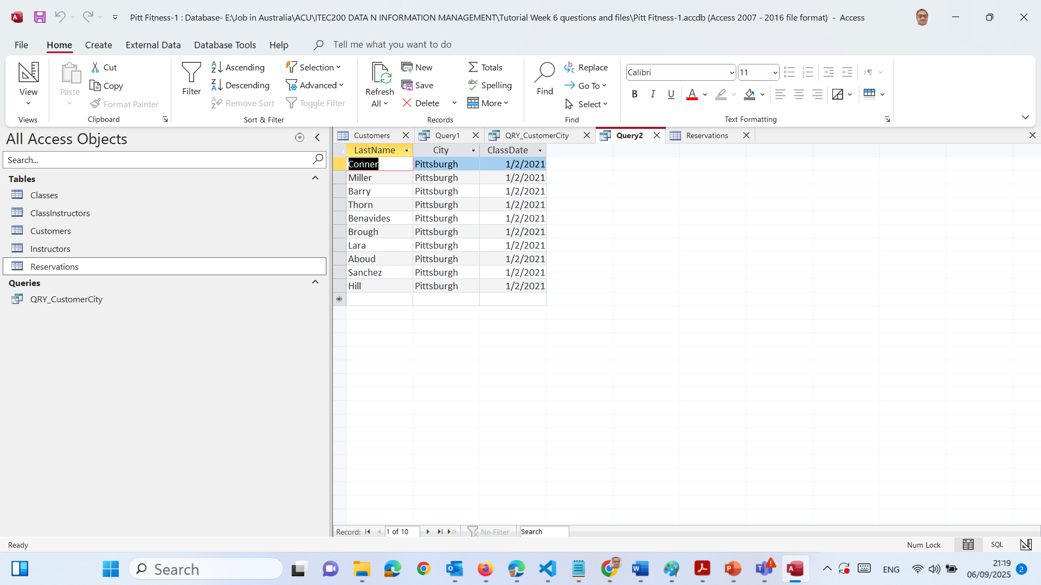
Hands-on Activity 2: Filter Reservations by Date & Day (OR)
5. Run → we’ll see only customers who had reservations on that date

Slide 49
Building Flexible Queries
What:
Use Totals, Grouping, and Expressions in queries.
Why:
To get summaries (not just raw data).
Analogy:
Like making a Pivot Table in Excel.
Example: Count how many customers are in each ClassType.

Slide 50
Hands-On Activity 3: Count Customers per ClassType
Task: Build and save a query that shows the number of customers in each ClassType.

Slide 51
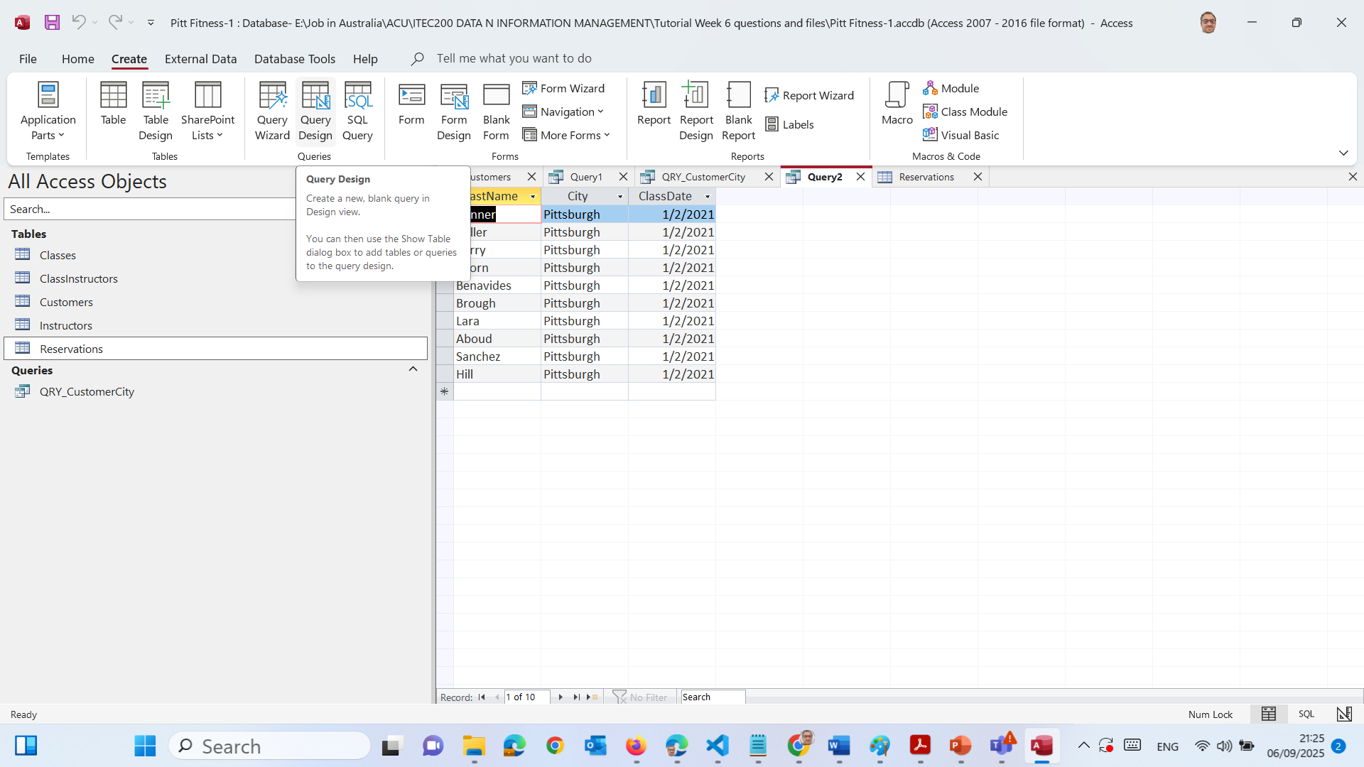
Hands-On Activity 3: Count Customers per ClassType
Go to Create → Query Design

Slide 52
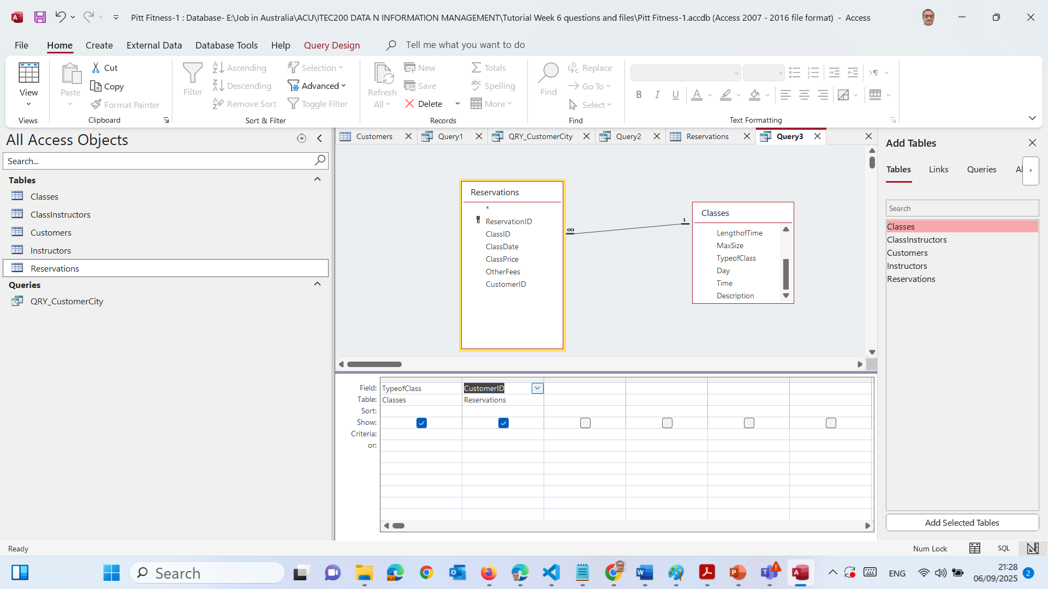
Hands-On Activity 3: Count Customers per ClassType
Reservations table → has the CustomerID (who booked).
Classes table → has the TypeofClass (what kind of class they booked).
2. drag:
TypeofClass (from Classes)
CustomerID (from Reservations)

Slide 53
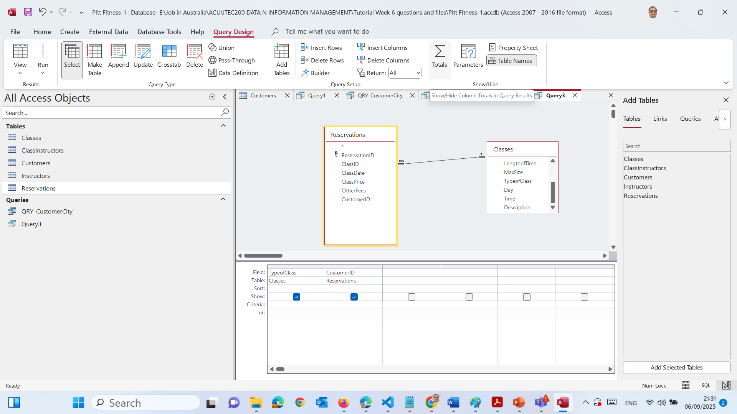
Hands-On Activity 3: Count Customers per ClassType
3. Click Totals (Σ) → new row “Total” appears.

Slide 54
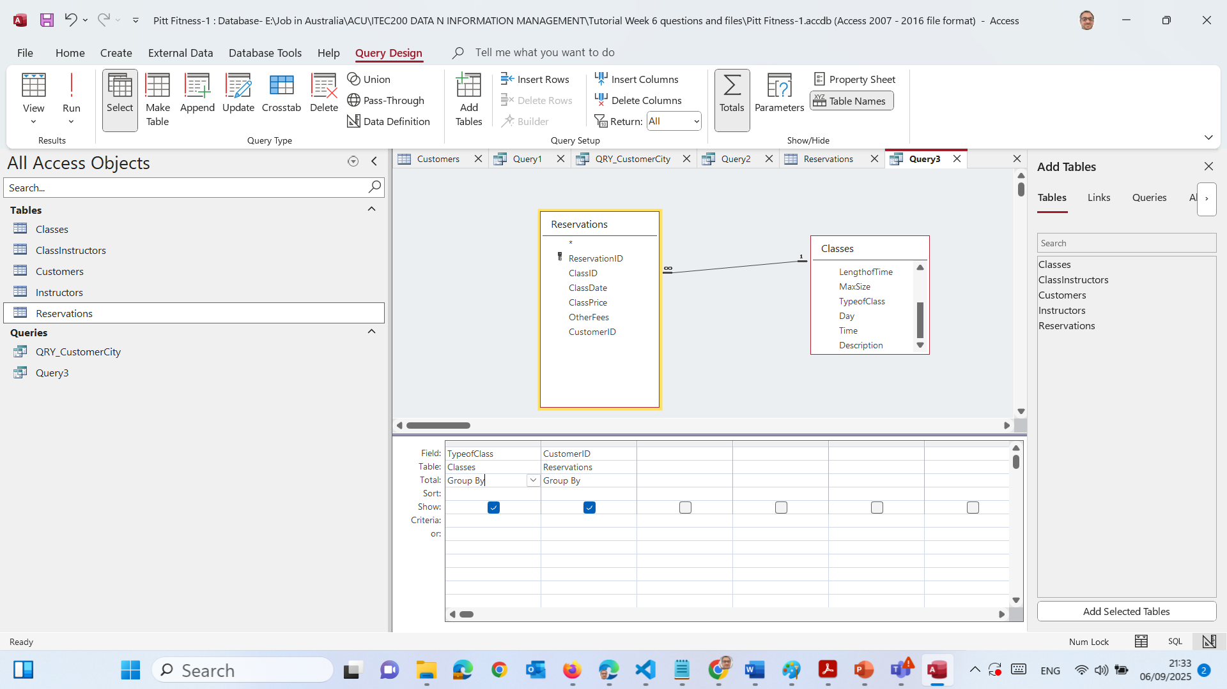
Hands-On Activity 3: Count Customers per ClassType
3. Click Totals (Σ) → new row “Total” appears.

Slide 55
Hands-On Activity 3: Count Customers per ClassType
4. Under TypeofClass → leave as Group By.

Slide 56
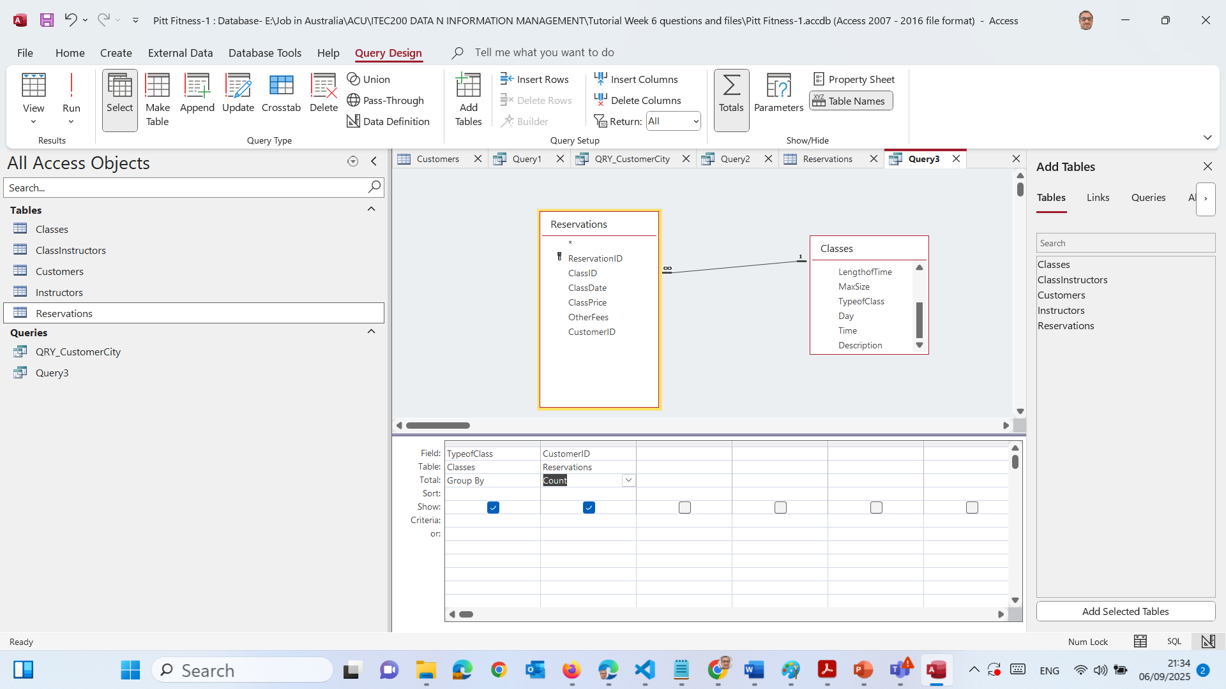
Hands-On Activity 3: Count Customers per ClassType
5. Under CustomerID → change to Count.

Slide 57
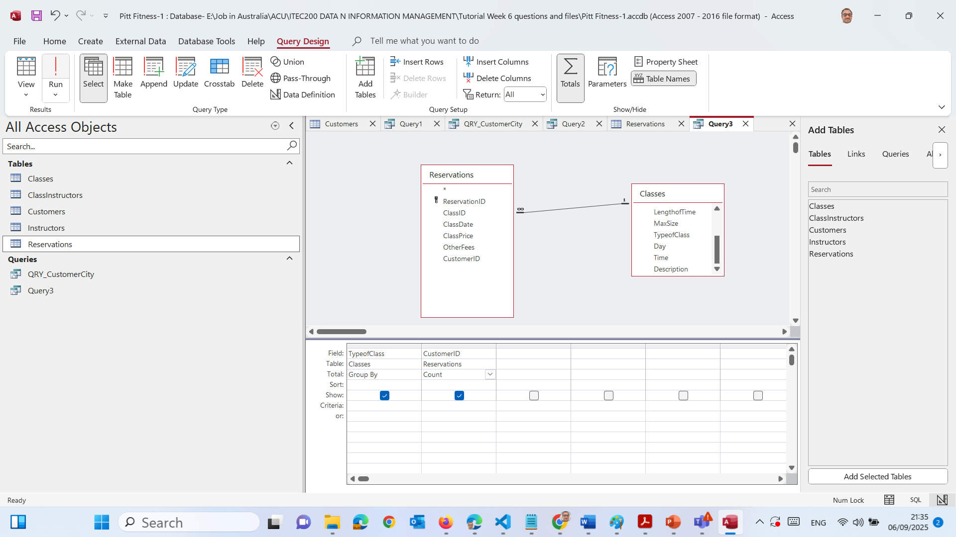
Hands-On Activity 3: Count Customers per ClassType
6. Run (!) → we’ll see each class type with a count of customers.

Slide 58
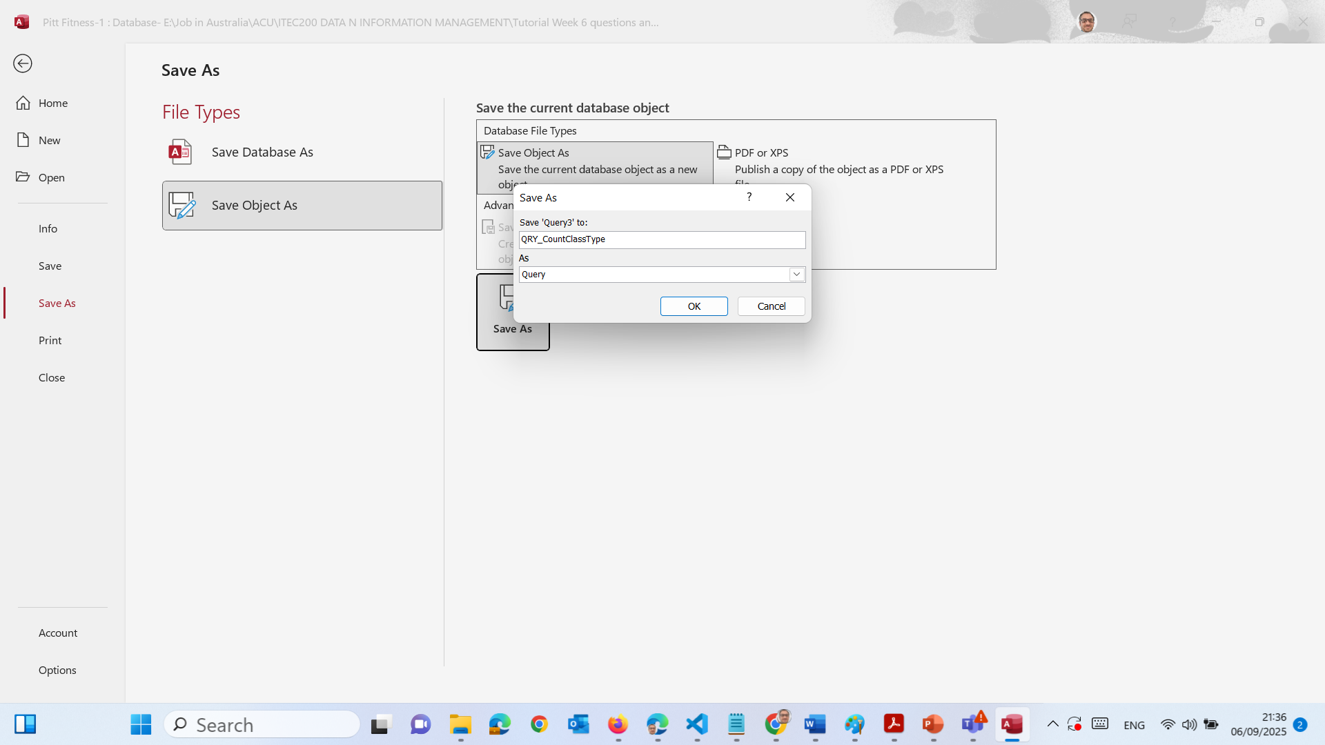
Hands-On Activity 3: Count Customers per ClassType
7. Save as QRY_CountClassType

Slide 59
Action Queries
What: Queries that change data, not just display it.
Types:
Update → change values
Delete → remove records
Append → add records to a table
Make Table → create a new table from results
Analogy: Like doing a bulk find-and-replace in Word.

Slide 60
Action Queries
Examples:
Update all Cardio class prices by +10%
Delete all reservations taught by Neda Tahan

Slide 61
Hands-On Activity 4: Update “Cardio” Prices (+10%)
Task: Increase ClassPrice by 10% for classes where TypeofClass = "Cardio".

Slide 62
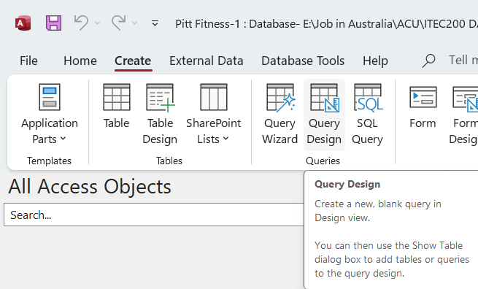
Hands-On Activity 4: Update “Cardio” Prices (+10%)
Create → Query Design

Slide 63
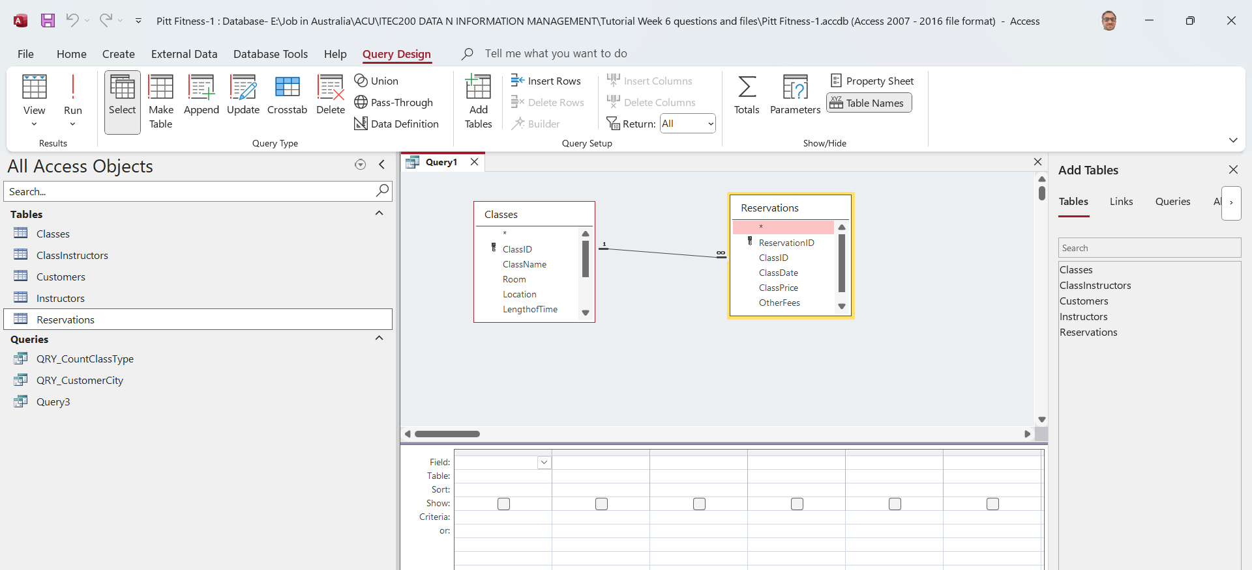
Hands-On Activity 4: Update “Cardio” Prices (+10%)
Add Classes and Reservations tables (they should join on ClassID).

Slide 64
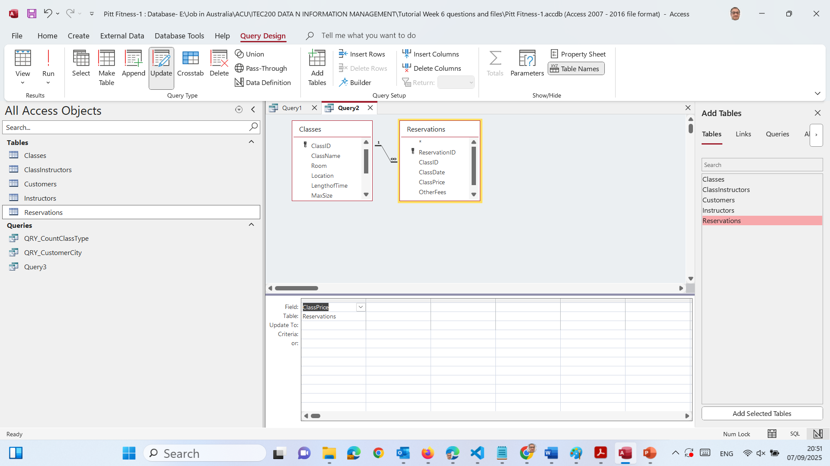
Hands-On Activity 4: Update “Cardio” Prices (+10%)
3. Choose the field to update
From Reservations, drag ClassPrice into the first empty column of the grid.

Slide 65
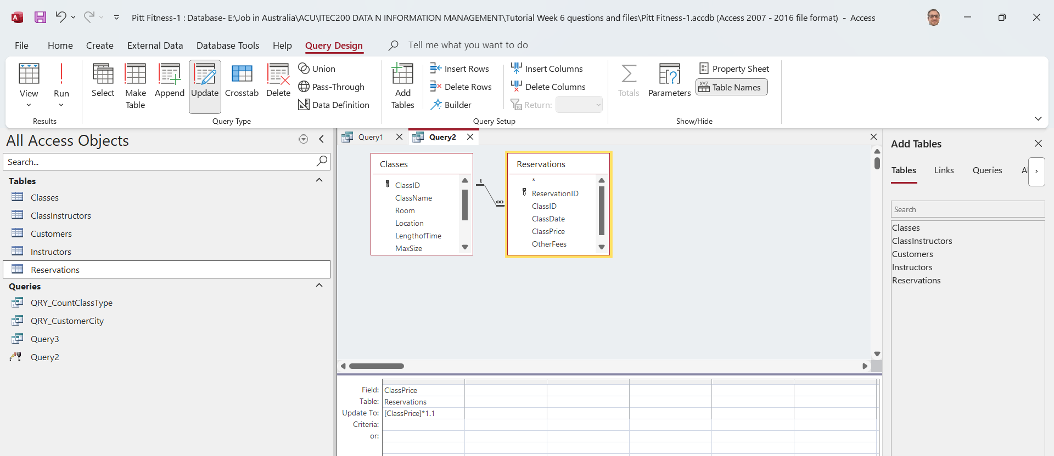
Hands-On Activity 4: Update “Cardio” Prices (+10%)
4. Tell Access how to update it
In the Update To row of that ClassPrice column, type: [ClassPrice]*1.1

Slide 66
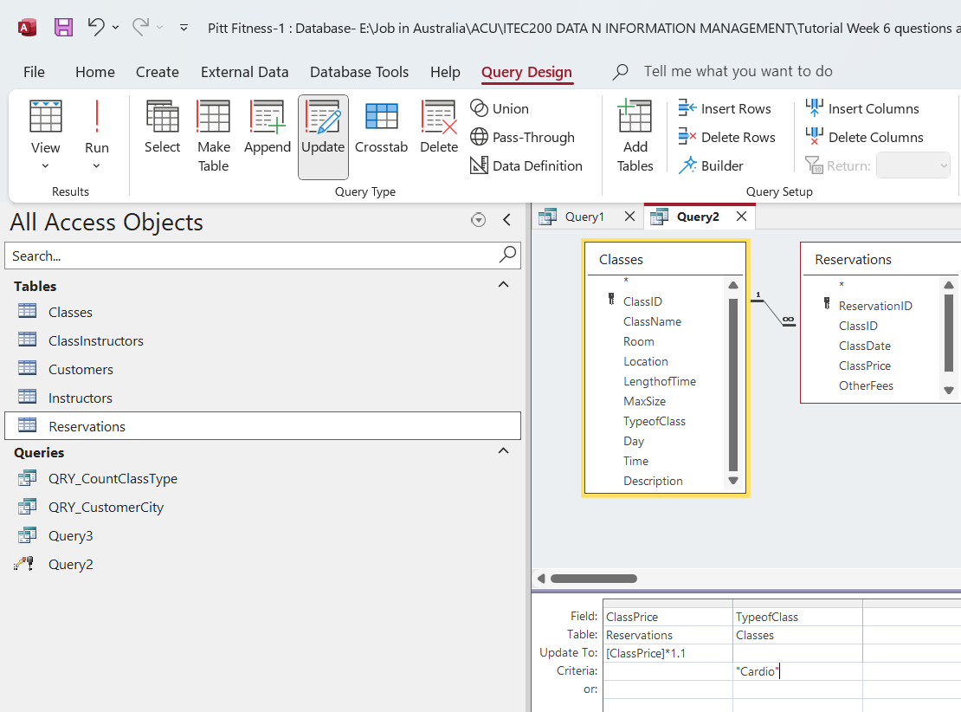
Hands-On Activity 4: Update “Cardio” Prices (+10%)
5. Filter to Cardio only (important!)
From Classes, drag TypeOfClass into a second column.
Leave Update To blank for this column.
In the Criteria row type: “Cardio”

Slide 67
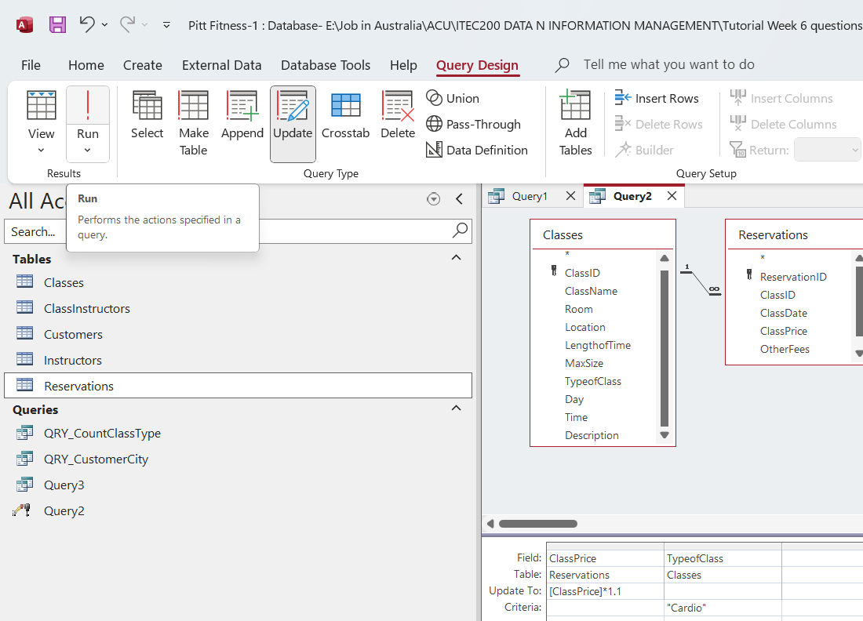
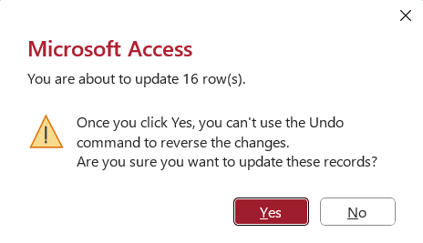
Hands-On Activity 4: Update “Cardio” Prices (+10%)
6. Run
Click Run (red !). Confirm the number of rows to be updated.
Open Reservations to spot-check a few ClassPrice values.

Slide 68
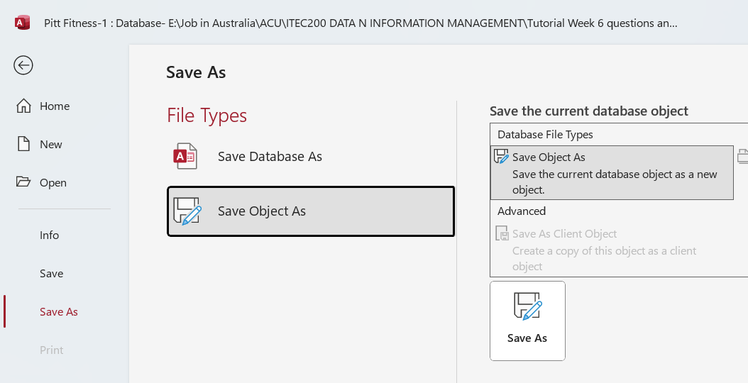
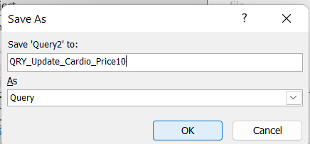
Hands-On Activity 4: Update “Cardio” Prices (+10%)
7. Save Object As QRY_Update_Cardio_Price10

Slide 69
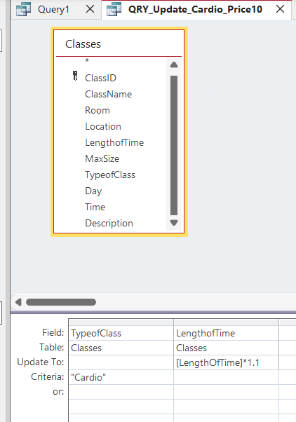
Hands-On Activity 4: Update “Cardio” Prices (+10%)
If we only update LengthOfTime instead:
Add Classes only (we don’t need Reservations).
Drag LengthOfTime to the grid.
Update To: [LengthOfTime]*1.1
Add TypeOfClass with Criteria "Cardio" as before.
Run and save as QRY_Update_Cardio_Length10.

Slide 70
Research / Debate Questions
Q1: Why use QBE instead of writing SQL directly?
Students: Easier for beginners, visual approach.
Q2 (Debate): Should we allow cascade deletes?
Yes: keeps DB clean. No: dangerous, may delete too much.
Q3: Compare Access Queries vs Excel Filters.
Access = reusable + relational. Excel = one-off + flat file.

Slide 71
Preparation for Tutorial Week 6
Install MS Access (if personal laptop) or use lab computers.
Download Pitt Fitness Database (provided on Canvas).
Add to Trusted Locations in Access (to avoid security warning).
Check that tables open correctly (Customers, Classes, Reservations, etc.).

Slide 72
Preparation for Tutorial Week 6
What to Do
Download & Open the Pitt Fitness Database
Use the file provided (Pitt Fitness.accdb).
If Access shows a security warning, enable content or add the folder to Trusted Locations.
Create Queries in Access
You must build Query1 to Query10 (Query11 is optional).
Each query must be saved with a meaningful name (e.g., QRY_CustomersOnJuly1).

Slide 73
Preparation for Tutorial Week 6
Follow the Criteria Carefully
Example: Query 1 needs customers with reservations on 1/7/2021. → Add Customers + Reservations tables, filter ClassDate = 1/7/2021.
Use Select queries for listing data, and Update/Delete/Append/Make-Table queries for Action tasks.
Check Results Before Saving
Always switch to Datasheet View to confirm that results look correct.
If the query shows too many or no rows, check your criteria.

Slide 74
Preparation for Tutorial Week 6
Save & Name Your Queries
Use names that match the task. Example: QRY_Cardio_WedFri.
Avoid leaving queries as Query1, Query2—that’s messy.
Submit Your Database
Submit the updated Access file (.accdb) with all queries saved inside.
Keep a backup copy in case something goes wrong.

Slide 75
Preparation for Tutorial Week 6
What to Avoid
Do not overwrite tables when testing action queries—always check which table you’re updating.
Do not submit screenshots of queries instead of the Access file.
Do not leave default query names (Query1, Query2)—this loses marks.
Do not hardcode wrong values (e.g., typing "Raymond" without checking instructor spelling). Use exact data from the tables.
Do not delete original tables—only work with queries.

Slide 76
Preparation for Tutorial Week 6
What to Submit
One Access database file (.accdb) with:
Queries 1–10 (Query 11 if attempted).
Each saved with a clear, meaningful name.
Make sure queries run correctly when opened by your tutor.

Slide 77
Preparation for Tutorial Week 6
Tips
Use Design View for precision, then switch to Datasheet View to check results.
Use wildcards (LIKE "M*") for names starting with "M".
Use aggregates (Totals) for counting (Query6, Query7, Query9).
Always test criteria step by step—start with a Select query before converting to an Action query.

Slide 78

Attendance

Slide 79

Let’s Answer Your Questions
Live during class – Ask directly during sessions.
Canvas Inbox – For structured academic queries.
Email – For formal communications or attachments.
Microsoft Team – Send a reminder if I did not reply after 3 business day

Slide 80

Happy Learning and Bright Futures Ahead! Dr. Farshid Keivanian Stay Connected: linkedin.com/in/farshid-keivanian github.com/FarshidKeivanian
Education is the most powerful weapon you can use to change the world. — Nelson Mandela

Slide 81
Thank You
Have a Great Learning Day!
Feel free to reach out with any questions!
Dr. Farshid Keivanian

